Slide 1

ANALYSIS OF BANK CUTOMER LOAN ELIGIBILTY
BY
180031412
180030039
180031474
180031259

Slide 2
ABOUT THE PROJECT
Banking system in India has been a vital part of every ones lives personally and in business point of view. A lot of customers place request for taking loans based on different criteria and for various reasons ,The most important procedure in sanctioning a loan has always been a tough job for the banking system.
With the help of Machine learning techniques we could simplify and accurately categorise the data of the customer different parameters, so we can get the results for those eligible customers whom we can sanction the loan in a proper ,safest and in the fastest way possible.

Slide 3
ABSTRACT
The precise outcome of this very project is to sanction the loan for the eligible customer through the bank in safest and in the most accurate way by possible by the data we surf using Machine learning.

Slide 4
Project workflow
Gathering Data
Data Preparation
Choosing a Model
Training a Model
Evaluation
Parameter tuning
Prediction

Slide 5
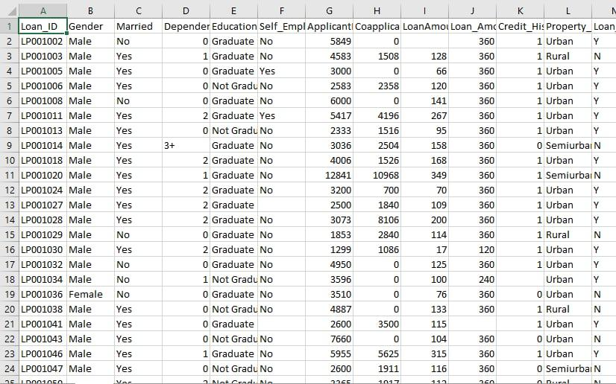
DATA SET

Slide 6
DATA SET DESCRIPTION
Variable | Description
Loan_ID | Unique Loan ID
Gender | Male/ Female
Married | Applicant married (Y/N)
Dependents | Number of dependents
Education | Applicant Education (Graduate/ Under Graduate)
Self_Employed | Self employed (Y/N)
ApplicantIncome | Applicant Income
CoapplicantIncome | Coapplicant Income
LoanAmount | Loan amount in thousands
Loan_Amount_Term | Term of loan in months
Credit_History | credit history meets guidelines
Property_Area | Urban/ Semi Urban/ Rural
Loan_Status | Loan approved (Y/N)

Slide 7
LIBARARIES USED
NUMPY
PANDAS
MATPLOT LIB
SEABORN
SKLEARN
TENSORFLOW

Slide 8
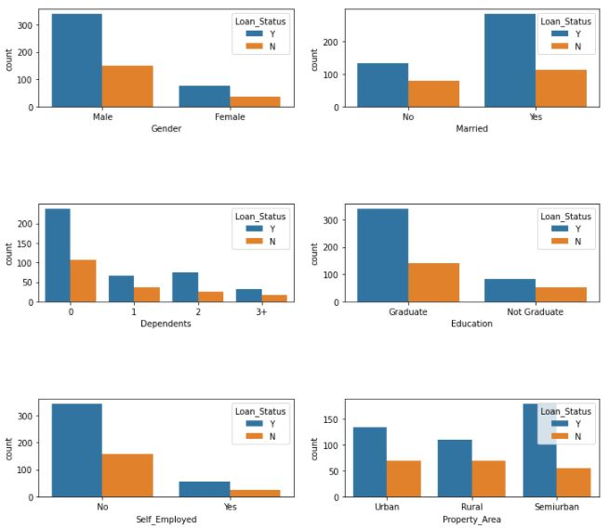
DATA ANALYSIS

Slide 9
FEATURE ENGINEERING
1) Imputation
2) Handling Outliers
3) Binning
4) Log Transform
5) One-Hot Encoding
6) Grouping Operations
7) Scaling

Slide 10
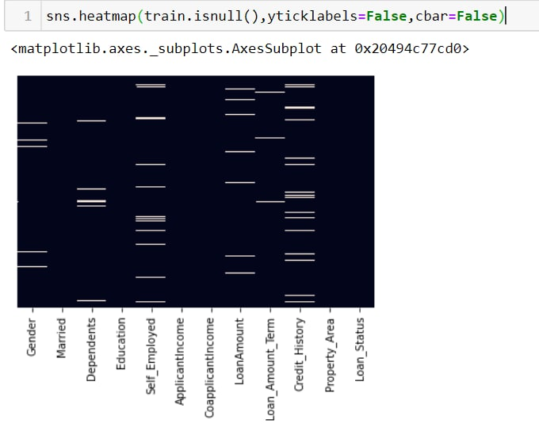
IMPUTATION
Implementing a heat map to find null values.
By observing heat map we can locate the null value present
-Gender
-Dependence
-Loan Amount ….

Slide 11
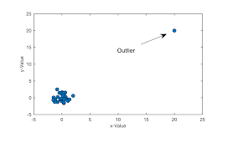
HANDLING OUTLIERS
An observation that appears far away and diverge from an overall pattern.
Reasons for outliers:
1.Data entry Error
2.Measurement Error
Treating outliers
1.Deleting outliers
2.Imputing outliers(like missing values)
3.Treat them Separately

Slide 12
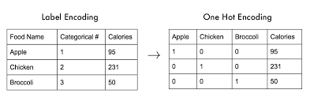
CATEGORICAL ENCODING
Categorical encoding is a process of converting categories to numbers.
We can handle categorical features in three ways:
-Label encoding
-One Hot Encoding

Slide 13
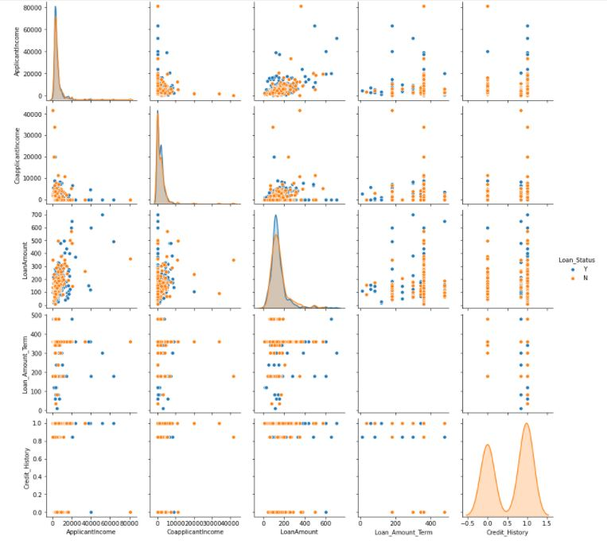
PAIR PLOT
By observing the above graphs we can say that there is a more overlapping between the 2 features .. so it's not better to use the logistic regression, KNN

Slide 14
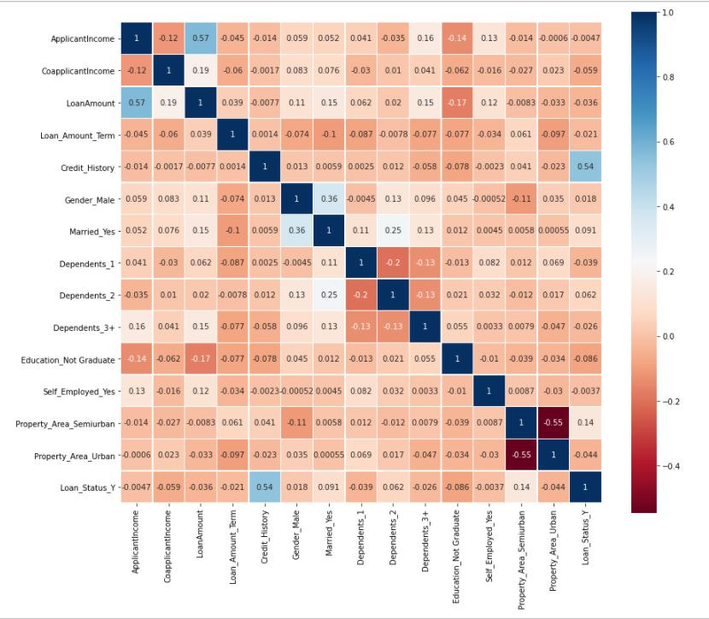
CORRELATION
Its finds the length and direction of linear relationship.
-PEARSON CORRELATION
-SPEARMAN RANK CORRELATION
In this data set we used Pearson correlation, The values always range between : (-1 to 1)
Close to 1 : + Direction
Close to -1: -Direction

Slide 15
MACHINE LEARNING MODELS
LOGISTIC REGRESSION
K NEAREST NEIGHBOR
RANDOM FOREST
SUPPORT VECTOR MACHINE
CHOOSING THE BEST MODEL
By comparing the accuracy we choose the best model

Slide 16
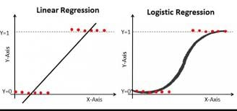
LOGISTIC REGRESSION
The dependent variable must be categorical
Logistic Regression is generally used for classification purposes
Falls under the family of Supervised Machine Learning Algorithms
We don’t output the weighted sum of inputs directly, but we pass it through a function that can map any real value between 0 and 1.
The dependent variable must be categorical

Slide 17
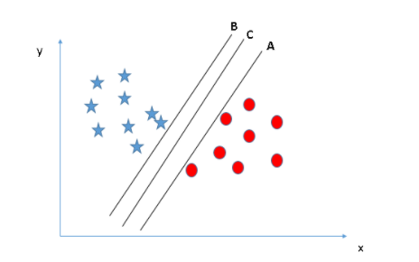
svm
“Support Vector Machine” (SVM) is a supervised machine learning algorithm which can be used for both classification or regression challenges
In the SVM algorithm, we plot each data item as a point in n-dimensional space

Slide 18
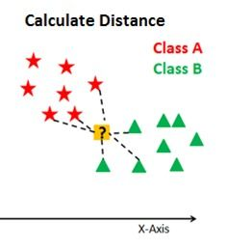
K nearest neighbor
Select the number K of the neighbors
Calculate the distance of K number of neighbors
Take the K nearest neighbors as per the calculated distance.
Among these k neighbors, count the number of the data points in each category.
Assign the new data points to that category for which the number of the neighbor is maximum.
Our model is ready.

Slide 19

Random forest
Random forest builds multiple decision trees and merges them together to get a more accurate and stable prediction.

Slide 20
Performance Metrics
For The Classification problem the Performance Metrics are :-
Confusion Matrix
Recall
Precision
Type-1,2 Errors
Accuracy
F-Beta Score
Roc/Auc Curve….

Slide 21
MODEL | TRAIN ACCURACY | TEST ACCURACY
LOGISTIC REGRESSION | 0.8921 | 0.8337
K N N | 0.8432 | 0.9237
RANDOM FOREST | 0.8959 | 0.8392
SVM | 0.8290 | 1.0

Slide 22
TENSORFLOW
In Tensorflow We can achieve our goal by using the following models:
1. Linear Classifier. 2. Neural Networks. 3. Support Vector Machines. 4. Decision Trees and Many more.
In this project we are working with neural networks

Slide 23
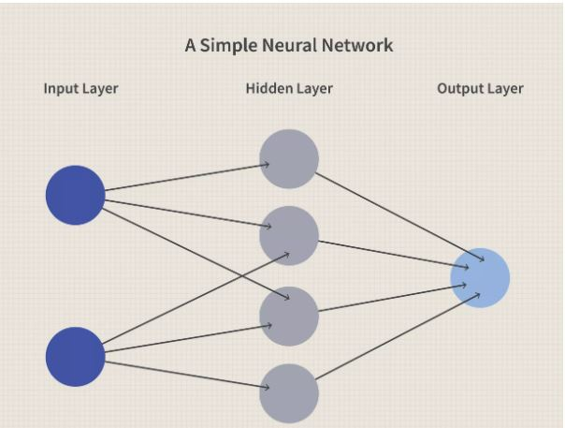
NEURAL NETWORKS
A neural network is a series of algorithms that endeavors to recognize underlying relationships in a set of data through a process that mimics the way the human brain operates.
In this sense, neural networks refer to systems of neurons, either organic or artificial in nature.
Neural networks can adapt to changing input; so the network generates the best possible result without needing to redesign the output criteria

Slide 24
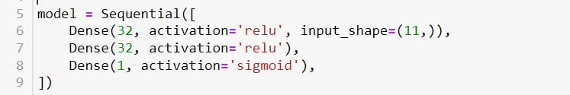
WORKING
The framework for defining a neural network as a set of Sequential layers is called keras
The word dense is used to define a layer of connected neurons here we use 3 layers
Input_shape refers the number of inputs we are using

Slide 25

The above code compile our Neural Network. When we do so, we have to specify 2 functions, a loss and an optimizer.
The Loss Function is used to measure how good the current guess is
The Optimizer genarates a new and improved guess
ACCURACY WE ACHIEVED BY USING TENSORFLOW IS 0.8774

Slide 26
THANK YOU

